Slide 1
AP Macroeconomics – Week 1

Slide 2



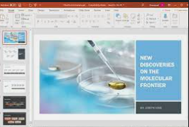



Mid Term Exam Preparation
All Units will be covered
Best preparation is practice exams!
Same format, same style of questions
I have taken questions from 2014, 2016, 2018 exams
If you find the practice exams too difficult then you should:
Attempt the Progress Check Questions for each unit
Look over my slides and summaries
Watch videos such as Khan Academy, ACDC economics, videos from Chinese content creators who do the same thing
Remember to use me as a resource.
Ask me questions in class
I am usually available at lunch time
Asking questions can often save you a lot of time and strengthen your knowledge
Ask your classmates as well

